Slide 1
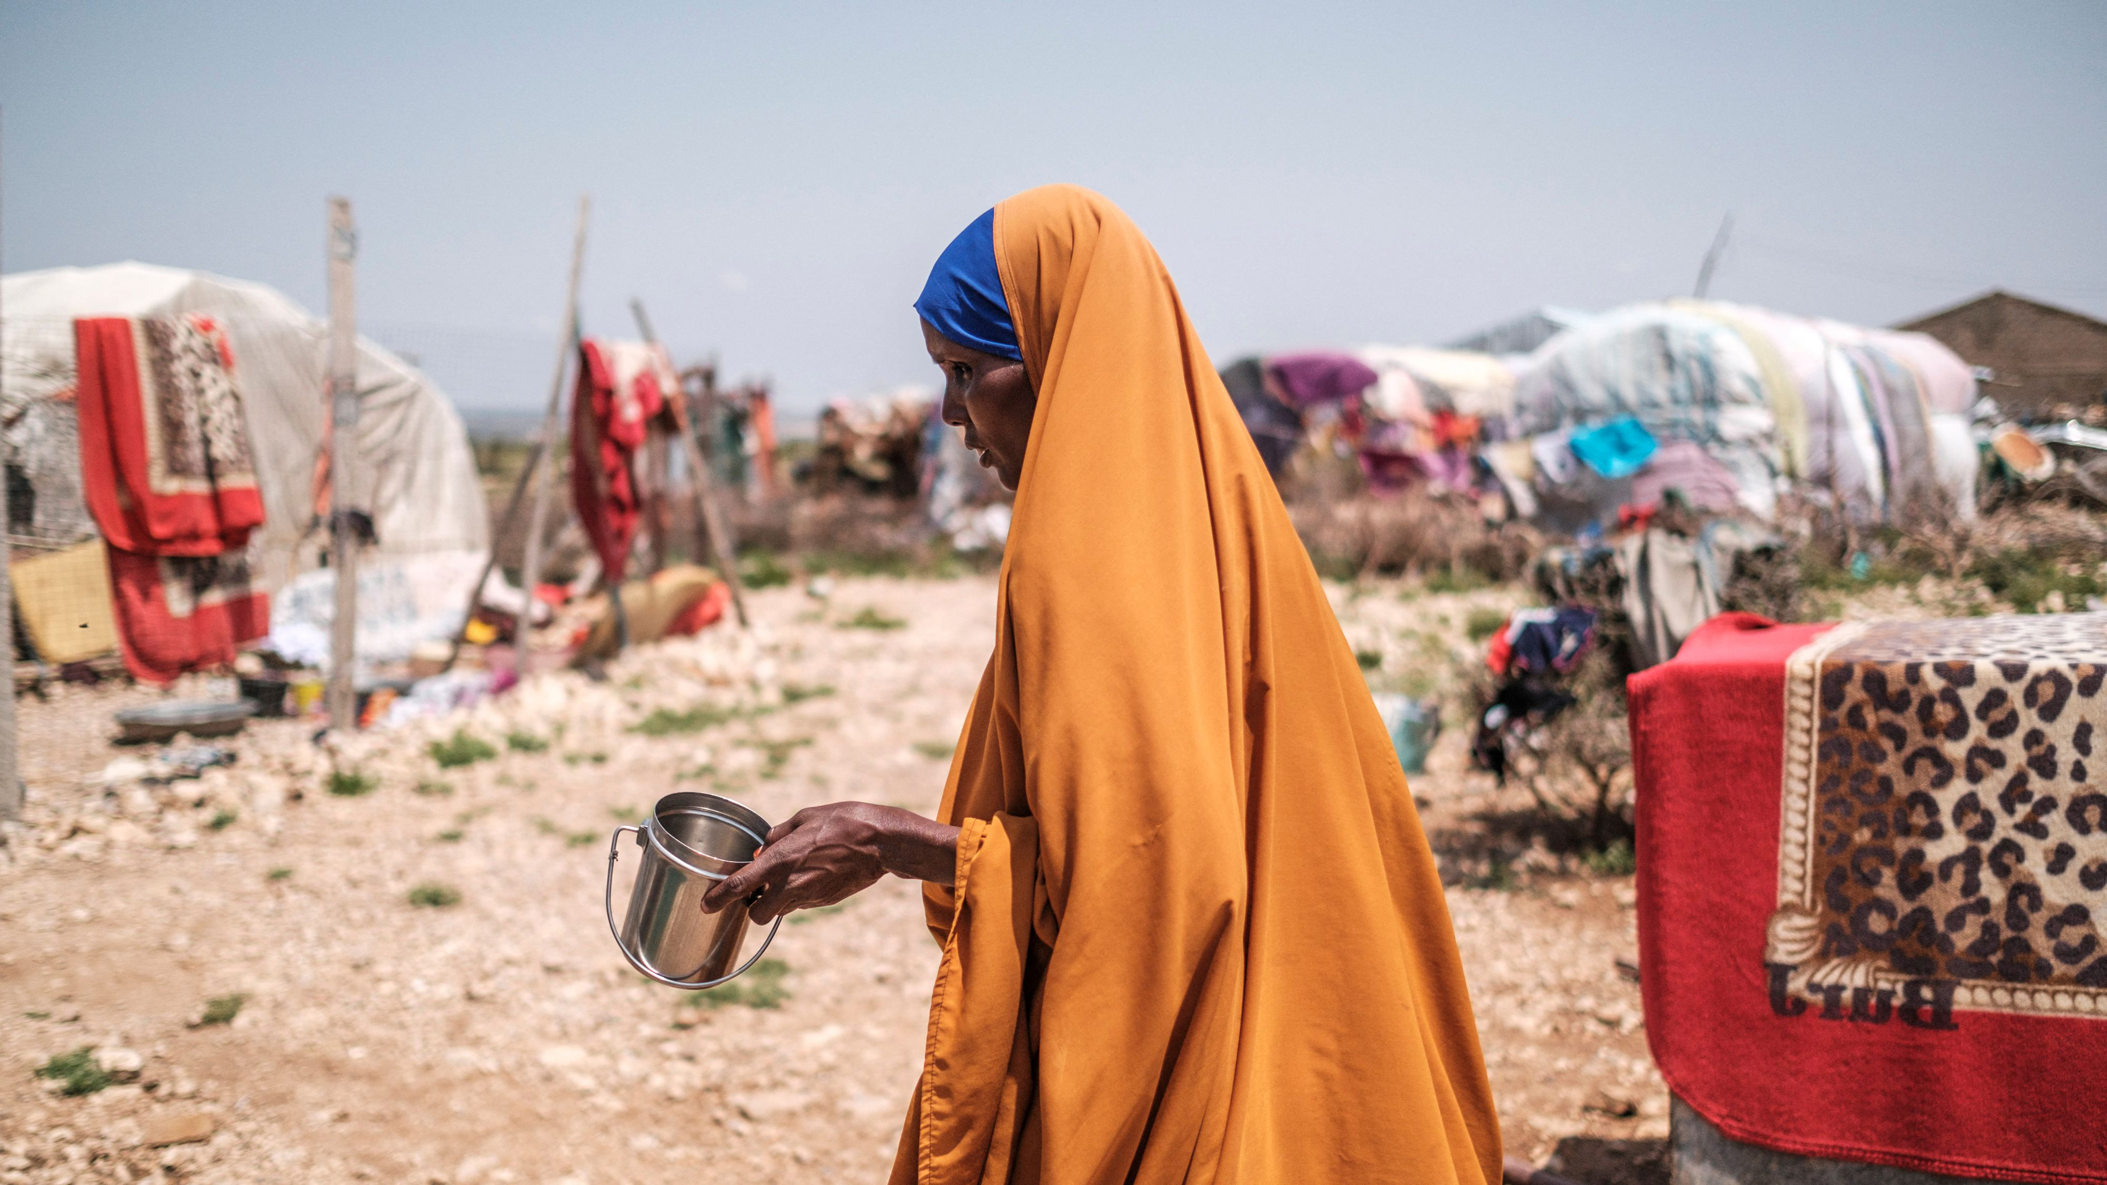
Human Security Challenges in the Horn of Africa
the combination of ongoing conflicts with climate change, which caused the worst drought and lack of water in the last 40 years, the invasion of locusts, COVID-19 economic afterwords and a sharp rise in prices, the conflict in Ukraine led to an unprecedented high level of regional humanitarian crisis.

Slide 2
Is it possible to say that a human security norms are really exist and is it possible to say that the lives of individuals and communities matter within global political discussion? And what are the legal and political implications for human security in armed conflicts?

Slide 3
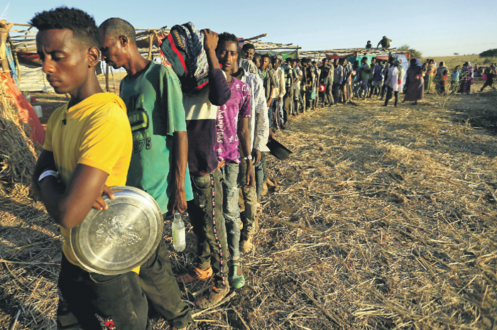
The Federal Democratic Republic of Ethiopia (FDRE) is a country at the epicenter of events. Here we meet with human security in an armed conflict In the state of Tigray, the ethnopolitical conflict between local authorities and the federal government, which began almost two years ago, resulted in a humanitarian catastrophe. At the meeting of the UN Security Council on the situation in Ethiopia, which took place on October 6, 2021, UN Secretary-General A.Guterres called it

Slide 4
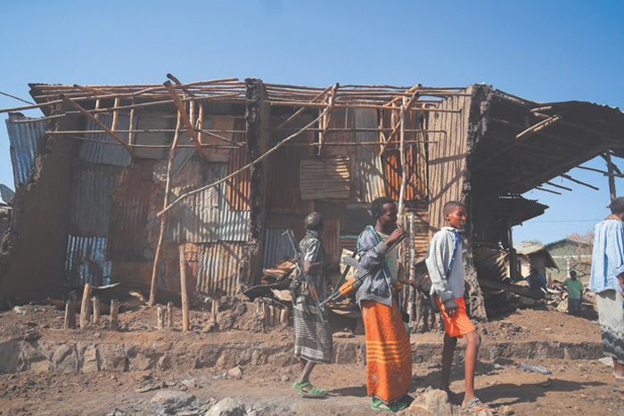
1 Ethnic cleansing In February 2021, Amnesty International stated in its report that in November 2020 Eritrean military killed hundreds of unarmed civilians in the town of Aksum, located about 187 km north of Makelle, as a result of indiscriminate shelling, extrajudicial executions and violent acts, which, according to the human rights organization, amounts to a crime against humanity. The massacre in Axum Amnesty International 2021 // https://www.amnesty.org/download/Documents/AFR2537302021ENGLISH.PDF

Slide 5
2 Food security Michael Dunford, Regional Director for Eastern Africa, World Food Program You have food that is ever so close to people, but it’s not delivered to people who are in desperate need of it. Not because the food is not available. Not because the expertise are lacking. But because of a slow burning tactic from the Ethiopian authorities, federal authorities, to deny these people food» Abdullahi Boru Halakh Senior Advocate for East Africa, Refugees International For the Ethiopian government for the last two years, this is a tactic of war. Food is a tactic of war" Overcoming Barriers to Humanitarian Access in Northern Ethiopia Center for Strategic and International Studie Thursday, September 29, 2022 at 9:00 a.m. ET TRANSCRIPT// https://csis-website-prod.s3.amazonaws.com/s3fs-public/event/ts220930_NoEthiopia_Huamitarian_Access.pdf?X0_x7OZrU1GPWE0kNwpuG71x.zTVCI0Y

Slide 6
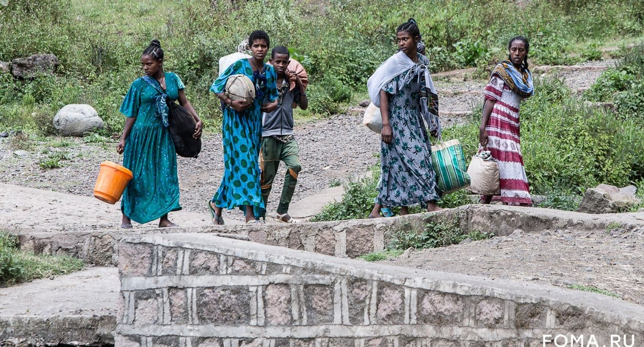
3 Refugees and internally displaced persons.
The flow of refugees from Tigray to Sudan is especially large, almost half of them belong to the minor age group. One of the most vulnerable groups is Eritrean refugees

Slide 7
Attempts by the international community to resolve the conflict
The official representative of the Ministry of Foreign Affairs, Maria Zakharova, at the end of October 2021, called for a peaceful settlement of the conflict and an unconditional ceasefire to stabilize the difficult economic and humanitarian situation.
In August 2021, US President Joe Biden called for a ceasefire in Tigray and demanded an end to human rights violations in the state
The Special Envoy of the African Union to Ethiopia, former Nigerian President Olusegun Obasanjo, made a lot of efforts to create the possibility of negotiations by contacting the leaders of both sides of the conflict.
As a result, negotiations began in Pretoria on October 24, 2022. On November 12, the agreement was signed by both parties and и Obasanjo says that "humanitarian access will begin immediately, the bulk of it will go by road, but we have also streamlined air transport for the same

Slide 8
Implications for human security in armed conflicts
international humanitarian law in the context of armed conflict in Ethiopia
In a situation of a humanitarian crisis of this magnitude, the significance and features of IHL lie in the possibility of a reasonable legal qualification of an armed conflict and control over the application by the belligerents of the provisions of the Geneva Conventions protecting victims of war of 1949 of 1949 and Additional Protocols II of 1977
It also seems significant to make more efficient use of the content of existing regional international treaties that are designed to provide assistance to forced migrants, and to combine national legal institutions of protection and the efforts of the interstate community in relation to such persons.

Slide 9
Political Implications human security in armed conflicts
Despite Human security is a universal concern; it affects all people in all areas of the world, the very idea that among a significant group of states and international organizations exists consensus of human security as a global norm is a phantom.
It does not correspond to reality within global political discussion
The main problem is that today all the warring parties put military and political calculations above humanitarian ones.
Therefore, this lays a mine of great power on the very idea of human security!

